Slide 1



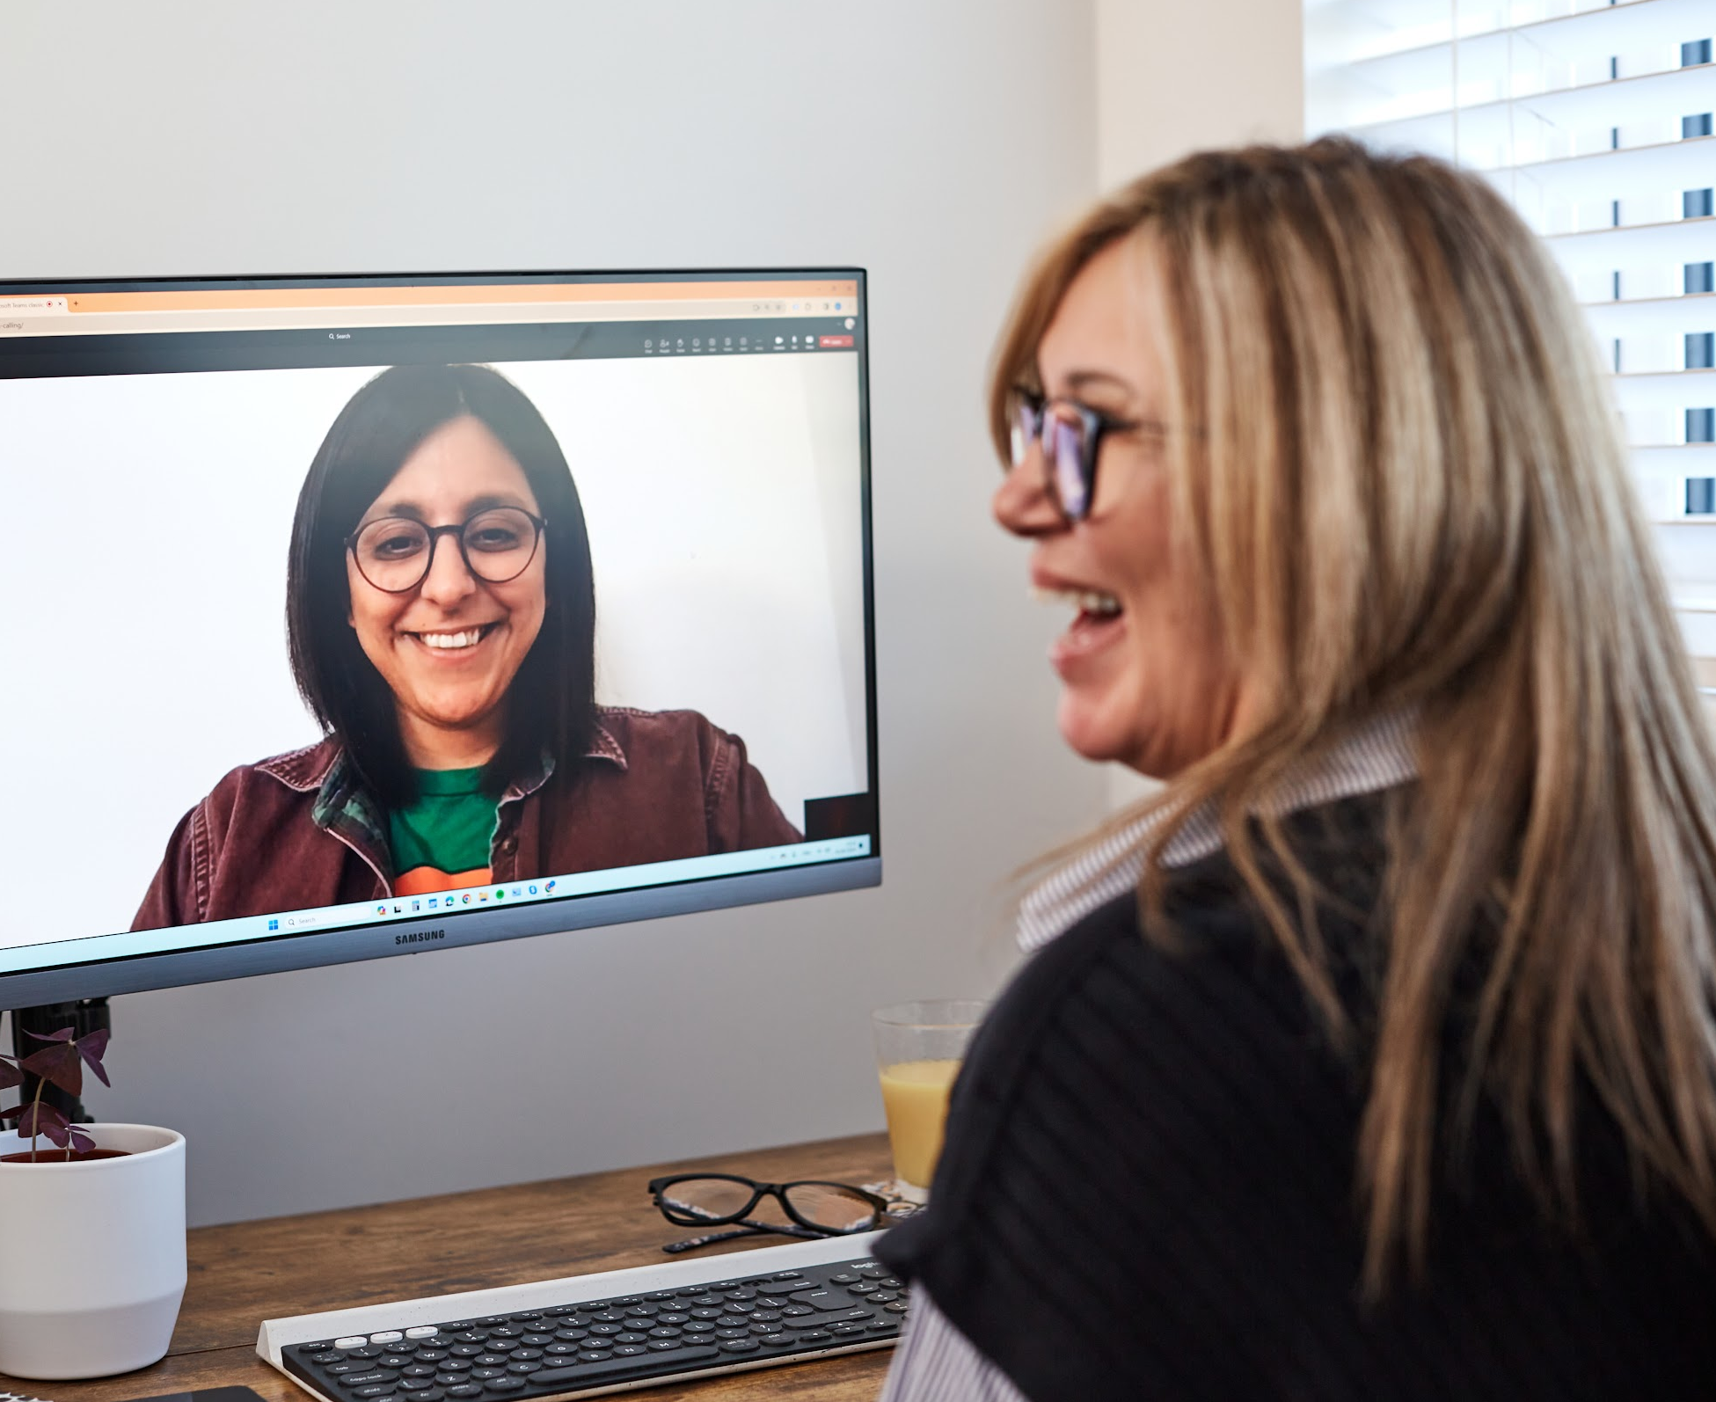
Impact Report
Intention to Action
2024 - 2025
sendittoalex.co.uk
Linked In
hello@sendittoalex.co.uk

Slide 2
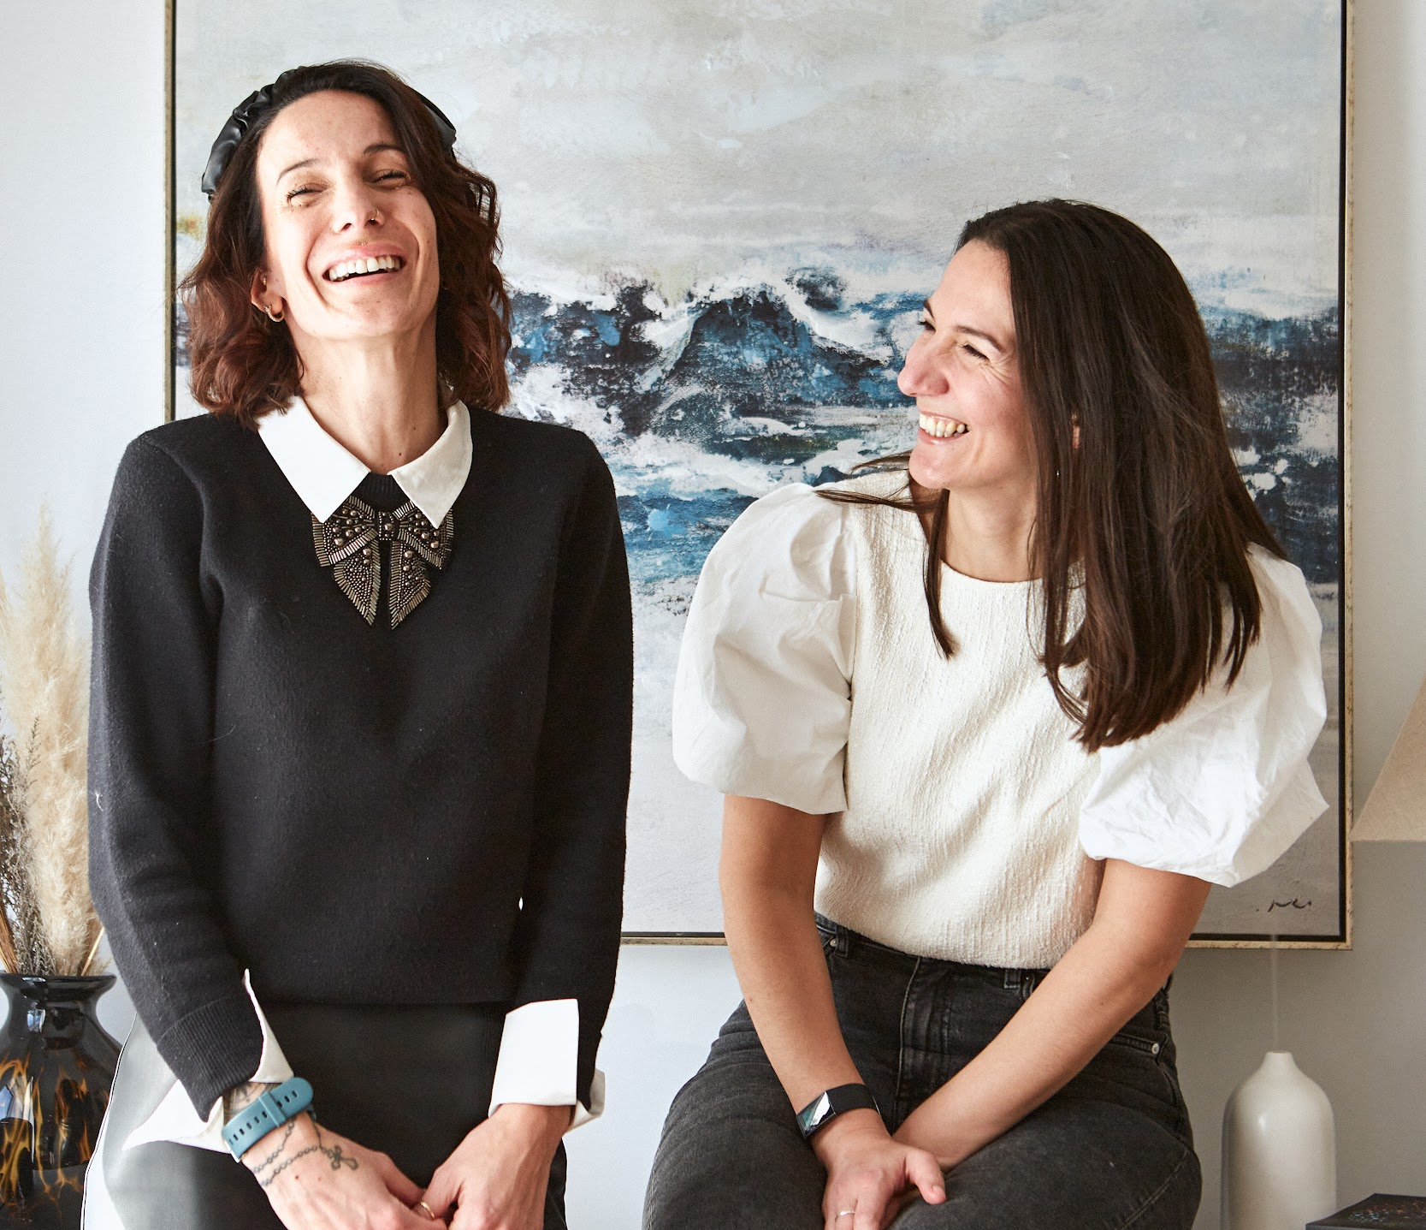
Leadership
Leadership Letter
This year, we’re proud to to share insights into our continued growth and impact as a certified B Corp.
Our improved score — from 89 in 2023 to 111.4 in 2025 — demonstrates our commitment to building a workplace and service model that centres the neurominority experience.
We know that change doesn’t come from good intentions alone, but from the systems we build and the values we live each day. This report shares the progress we’ve made, the voices we’ve listened to, and the steps we’re taking to shape a more inclusive future of work.
Alex & Lillie Jamieson
Co founders, Send It To Alex

Slide 3

B Corp
What is B Corp and why does it matter to us?
B Corp is a global movement that promotes responsible business practices focused on social and environmental impact.
Certified B Corporations meet rigorous standards across five key impact areas: Governance, Workers, Community, Customers, and Environment. In the UK alone, there are over 2,000 B Corps committed to using business as a force for good.
Being part of the B Corp community is a natural extension of our mission. It validates our commitment to equity, inclusion, transparency, and systemic change — and gives us a framework for doing better, year after year.

Slide 4
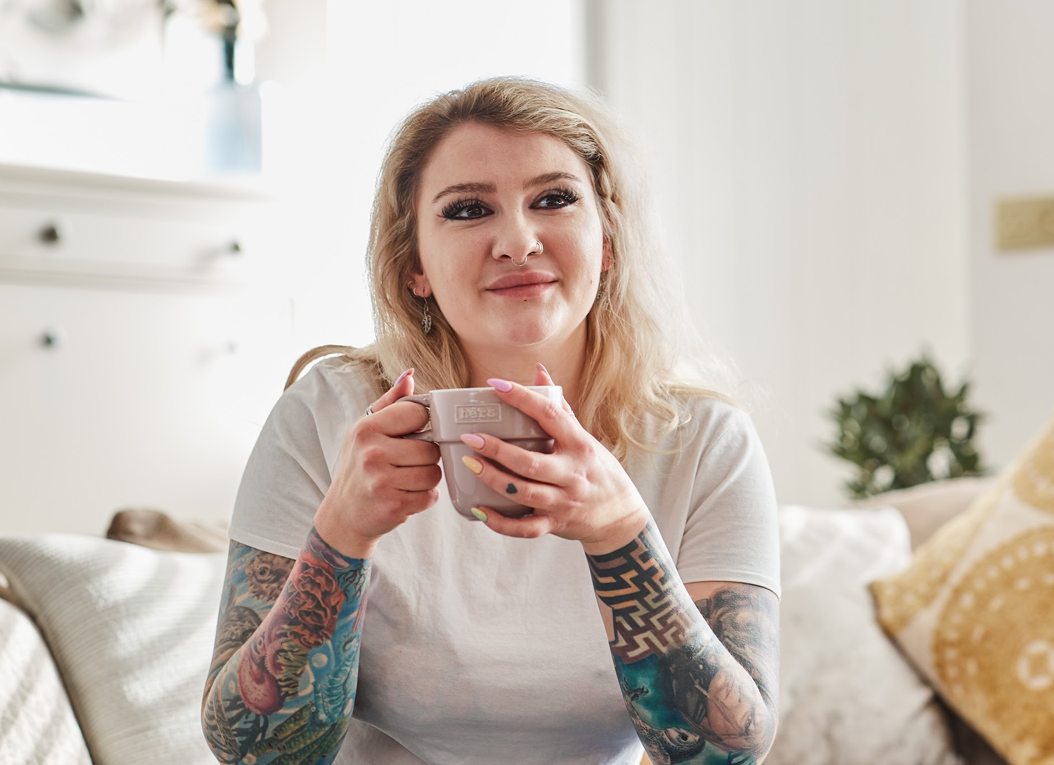
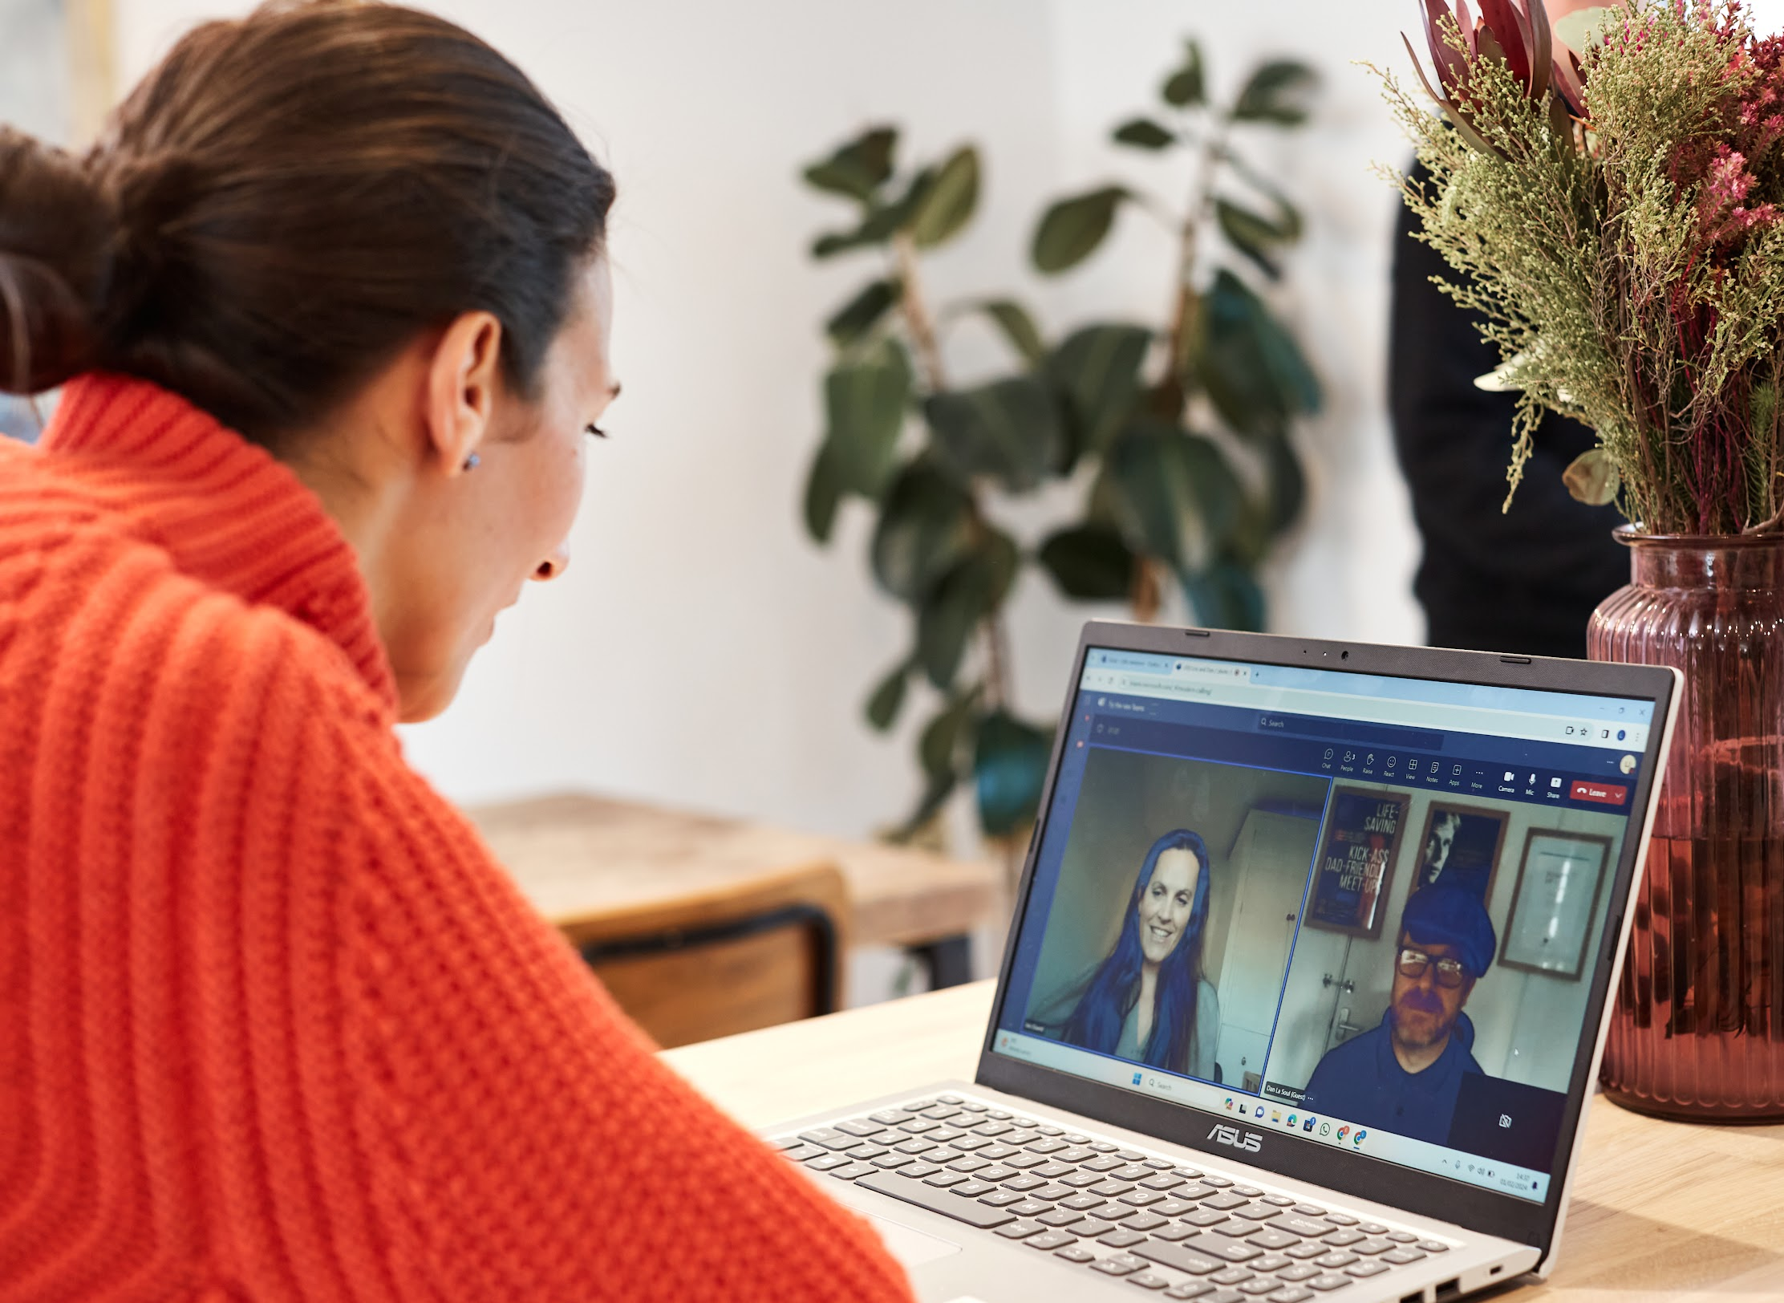

Services
Services at Send it to Alex
1
2
3
Support Worker Service
Neurodiversity Training
Virtual Assistance Service
Communication, executive function and administration support for neuro minority individuals at work.
We provide teams, managers and support workers with knowledge, tools, and strategies to effectively support neuro minority employees while fostering more inclusive environments for all.
Bespoke administrative and business support for Purpose-Led Businesses, to help leaders and teams amplify their organisation’s impact and make a real difference.

Slide 5
B Corp Score
Recertification
Recertification
We have improved our score by 22.4 points across all B Corp impact areas.
50 Average Score in the UK
80 Score for businesses to be certified
111.4 Send it to Alex B Corp Score

Slide 6


Governance
18.7
Governance
What we said we would do
Develop clear ethical frameworks
Work towards Disability Confident Status
Deepen Stakeholder engagement
What we said we would do
Created and implemented a comprehensive Code of Ethics
Became a Level 2 Disability Confident Employer
Conducted regular stakeholder feedback sessions and focus groups
Integrated social/environmental principles into training and decision-making
What we said we would do
Develop clear ethical frameworks
Work towards Disability Leader Status
Deepen Stakeholder engagement
What we will do next
Advance to Level 3 Disability Confident Leader status
Create an internal stakeholder advisory group to shape inclusive practice
Advisory Board…

Slide 7

Workers
Workers
33.6
What we said we would do
Support holistic team wellbeing
Ensure fair compensation and access to benefits
What we did
Increased starter wage to 10% above UK Living Wage
Conducted a staff training needs survey to inform new learning content and provided coaching where immediate needs where identified.
Expanded reasonable adjustments policy and flexible working
What we will do next
Develop a tailored mental health support programme for all staff
Introduce annual wellbeing budgets for all staff
Launch an internal mentorship scheme focused on progression
What we will do next
Advance to Level 3 Disability Confident Leader status
Create an internal stakeholder advisory group to shape inclusive practice
Advisory Board…

Slide 8

Community
Community
21.6
What we said we would do
Expand community-based impact and education
Increase pro bono services to underserved groups
What we did
Co created a Neurodiversity Training programme to better support neurominority individuals at work
Offered mentorship to individuals from underrepresented backgrounds
Provided a series of free neurodiversity focused webinars
What we will do next
Formalise a pro bono programme with dedicated quarterly targets
Develop a community partner directory to expand impact reach
Publish case studies on the outcomes of our community training
What we will do next
Advance to Level 3 Disability Confident Leader status
Create an internal stakeholder advisory group to shape inclusive practice
Advisory Board…

Slide 9

Community
85%
We made neuro-inclusion a core capability by training our full support-worker network.
gained increased confidence in delivering support for neuro minority individuals.
100%
of respondents reported an improved understanding of neuro inclusive practices
90%
said training enhanced their ability to advocate for neuro inclusivity in and outside of work.

Slide 10

Governance
Customers
30.4
What we said we would do
Continuously improve quality and ethics in customer engagement
What we did
Ran comprehensive customer surveys and incorporated feedback into service design
Met or exceeded satisfaction benchmarks across all services
Implemented neuro Inclusive communication guidelines
What we will do next
Create an accessible customer impact dashboard to share outcomes
Co-design future service improvements directly with our customer community
Provide more digital resources across our socials and website
What we will do next
Advance to Level 3 Disability Confident Leader status
Create an internal stakeholder advisory group to shape inclusive practice
Advisory Board…

Slide 11

Customers
85%
Our neuro-inclusive approach is delivering improved outcomes for the people we support.
experienced a substantial boost in productivity due to the support.
81%
of respondents reported their support had improved their financial stability
90%
reported a significant improvement in their work-related well-being.

Slide 12

Environment
Environment
7
What we said we would do
Reduce environmental footprint of our operations
What we did
Continued remote-first operations to reduce commuting emissions
Made environmentally responsible procurement choices
Initiated internal discussions around digital sustainability
What we will do next
Conduct an energy audit of our digital tools and platforms
Introduce a sustainable home-working guide for staff
Commit to low-impact digital marketing and file-sharing practices
What we will do next
Advance to Level 3 Disability Confident Leader status
Create an internal stakeholder advisory group to shape inclusive practice
Advisory Board…

Slide 13








Our vision is a world of work where everyone is included, empowered, and accommodated.
A world where neurodiversity is expected and celebrated, and where everyone has the opportunity to contribute to and benefit from paid work.
hello@sendittoalex.co.uk
P +44 (0) 7917 274 537
Linked In
sendittoalex.co.uk
lillie@sendittoalex.co.uk
P. 07712 429 811
Linked In
sendittoalex.co.uk
Follows us
Follows us

